Slide 1


REU - Electricity Infrastructure for Smart Cities
Cost-Benefit Analysis of Solar Batteries for a Single Residential Load in Tucson, Arizona
Lauren Lusk
Graduate Student Mentors: Salah and Saleh Alharbi
Faculty Mentors: Dr. Matin and Dr. Stefanovic

Slide 2
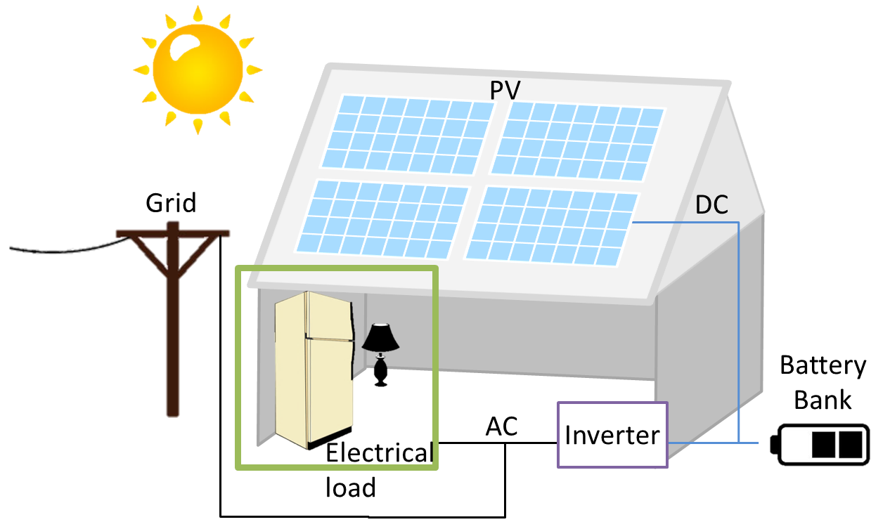
Overview
Notes:
Add diagram

Slide 3
Problem Statement
Determine the most cost effective batteries for a grid-connected PV home system in Tucson, AZ, provided by the current industry.

Slide 4
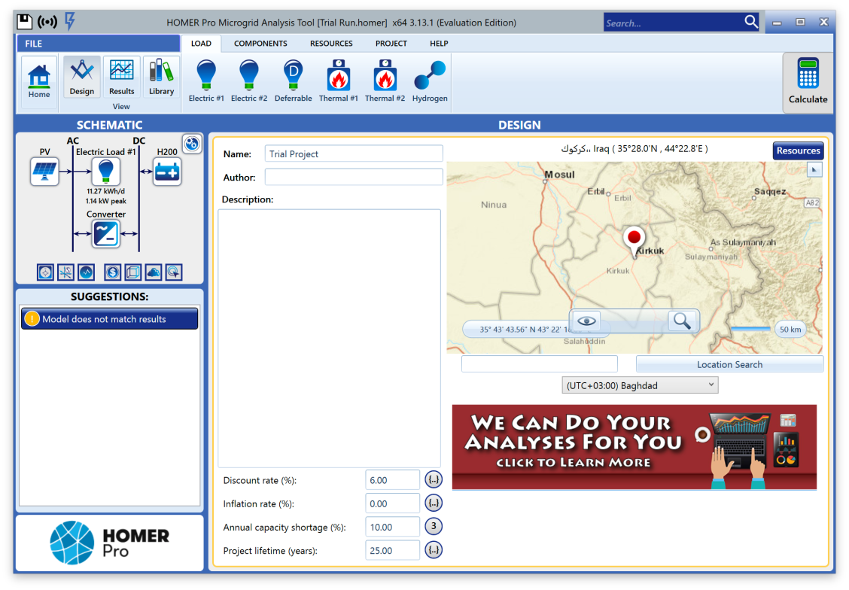
HOMER
Goal: Find the most cost-effective battery provided by current industry
  Solution: unknown
  Tool: Homer
Similar project: The Battery Characteristics Impact on Solar Systems: Performance and Cost
  S. Mahmood, A. Abdulabbas, H. Easa et al.
Key differences:
  batteries
    S. Mahmood et al. used 4 batteries of the same type
    I will use 3 different types of batteries
  grid connection
    S. Mahmood et al. only considered stand-alone solar system
    I will consider both stand-alone and grid-connected systems [1]

Slide 5
Arizona Solar Policies
One of the sunniest states (300+ days of sun)
  high solar potential
3rd in solar installation in the nation [2]
Solar Policies
    Federal Solar Tax Credit
      30% cost of solar instillation after 1st year
    State Tax Credit
      25% of total system cost (up to $1,000) [3]
    few rebate programs
    solar performance payments
    solar system does not increase property tax
    sales tax applies
    $0.70/kW monthly charge for new residential solar [4]
    2016: replaced net metering with net billing
      fixed rate for 10 years [5]
Notes:
https://seia.org/state-solar-policy/arizona-solar
https://www.solarpowerrocks.com/arizona-solar/#incentives
https://www.energysage.com/solar-panels/solar-rebates-incentives/az/

Slide 6
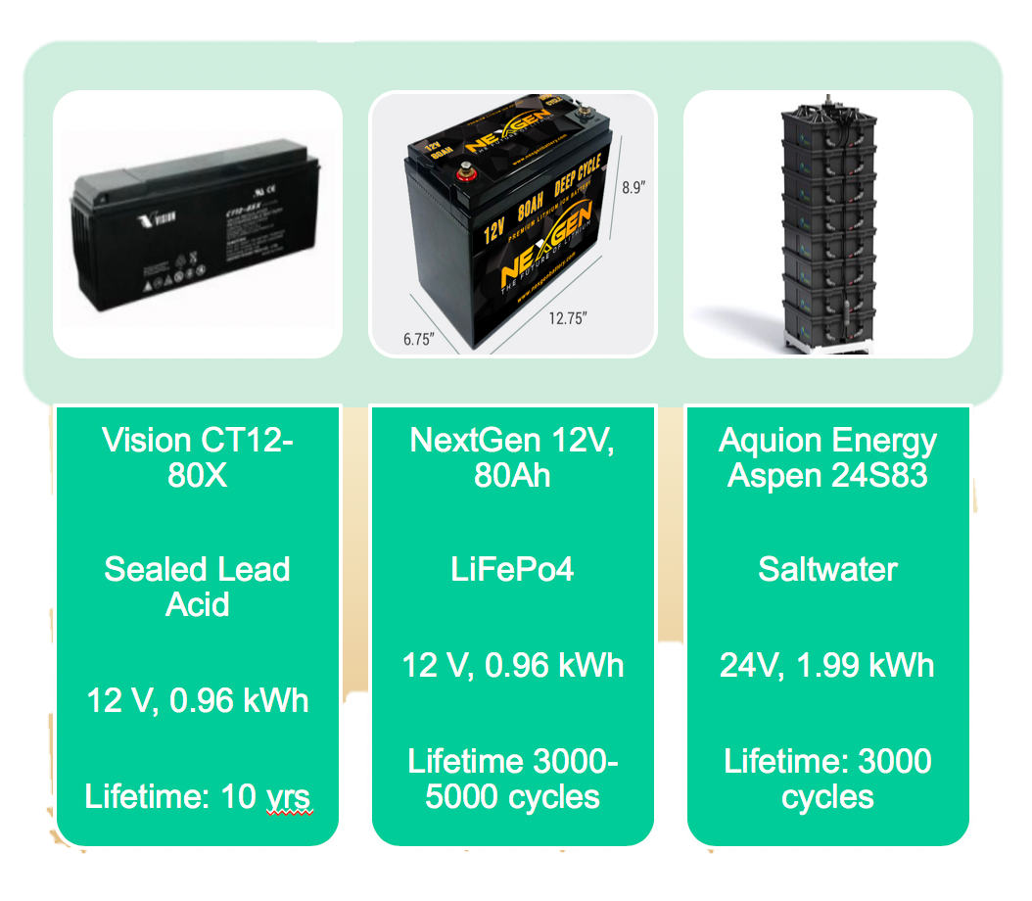
Batteries

Slide 7
Battery Characteristics
Battery | Cost per battery ($) | # cycles to 80% capacity | Max DOD (%) | Max Charge Current (A) | Min Charge Time from DOD 100% (Hr) | Self-discharge | Temp Range (°C)
Saltwater | $1,179.00 | 3000 | 100% | 20 | 4.15 | N/A | -5°C to 40°C
Lead-acid | $428.89 | 950 | 30% | 24 | 3.33 | 3%/month | -20°C to 60°C
Lithium-ion | $1,039.99 | 2000 | 90% | 80 | 1.00 | 3%/yr | -20°C to 60°C

Slide 8
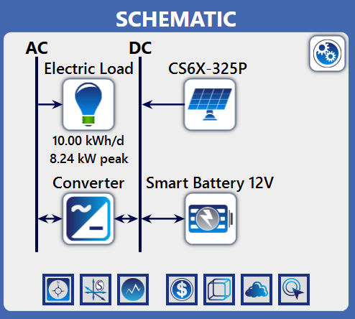
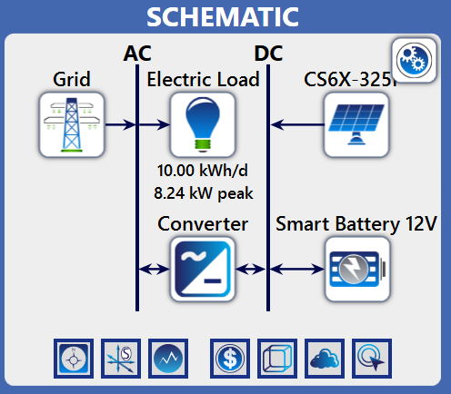
Simulation
Simulation Set-up
  CanadianSolar MaxPower CS6X-325P
    8 kW
  generic 1 kW converter
  load data from Open Energy Information
    island mode
      10 kWh
      15 kWh
    grid-connected mode
      25 kWh
      30 kWh
      35 kWh
Figure 1: Stand-alone Set-up
Figure 2: Grid-connected Set-up

Slide 9
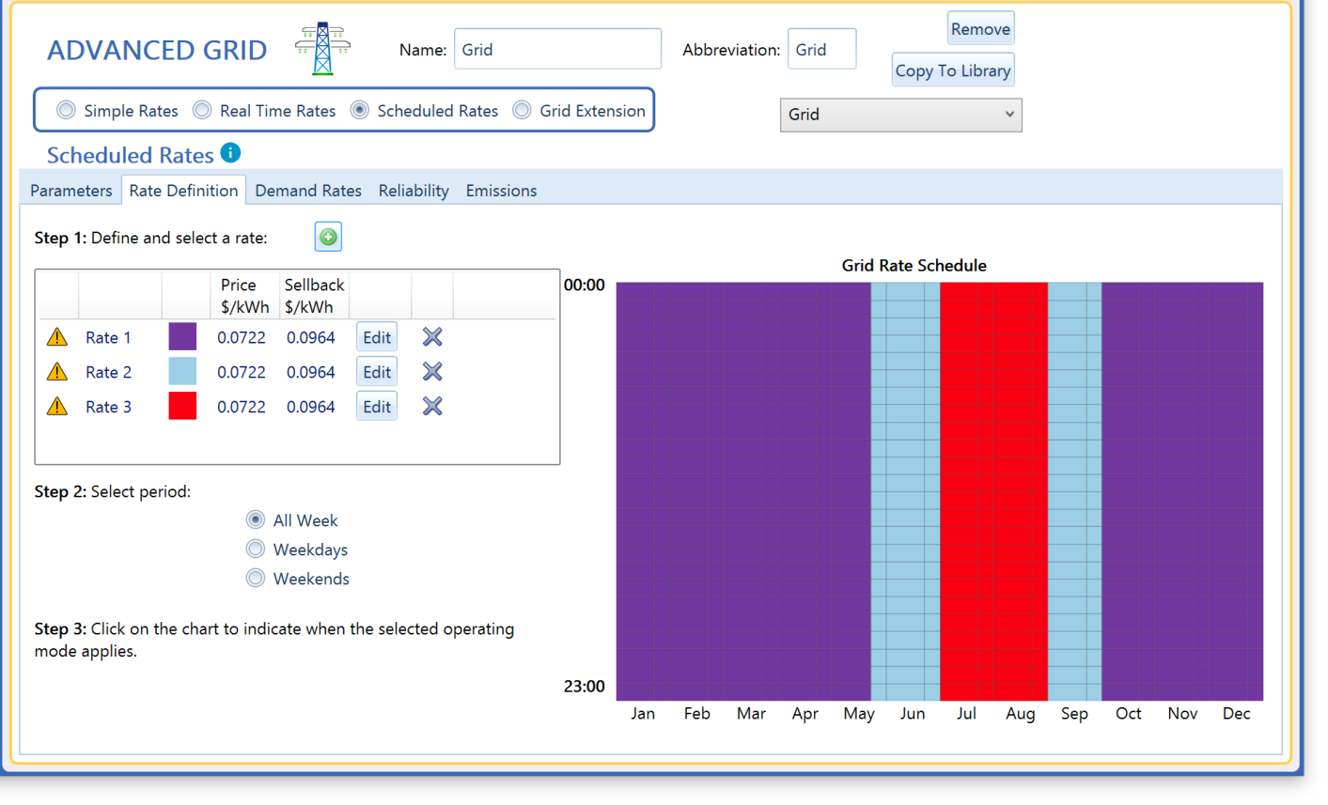
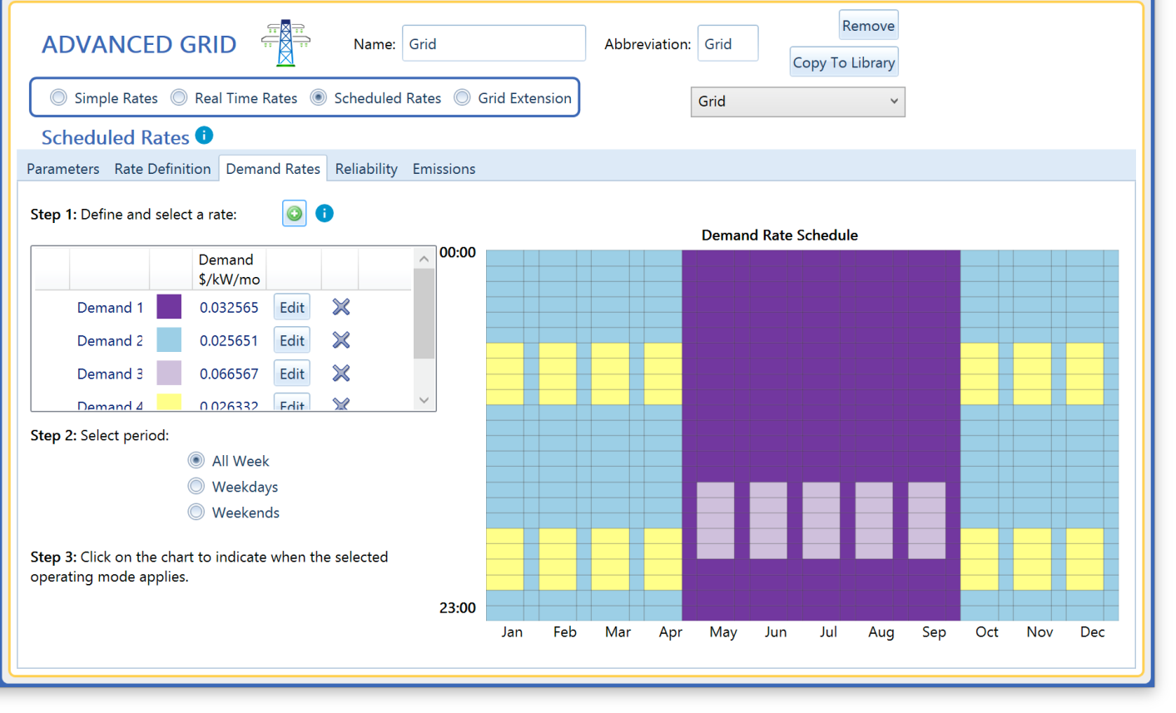

Slide 10
Calculations: Net Present Cost (NPC)
NPC is calculated for the entire system and for each component
NPC is the initial capital, replacement, operation, maintenance, and salvaging costs minus any revenue the system/component makes during the project’s lifetime
  HOMER adds all of the relevant costs together for each year of the projects lifetime
  The discount factor is applied to each years totals
  The totals for each year are summed, and the sign of the sum is flipped [6]

Slide 11
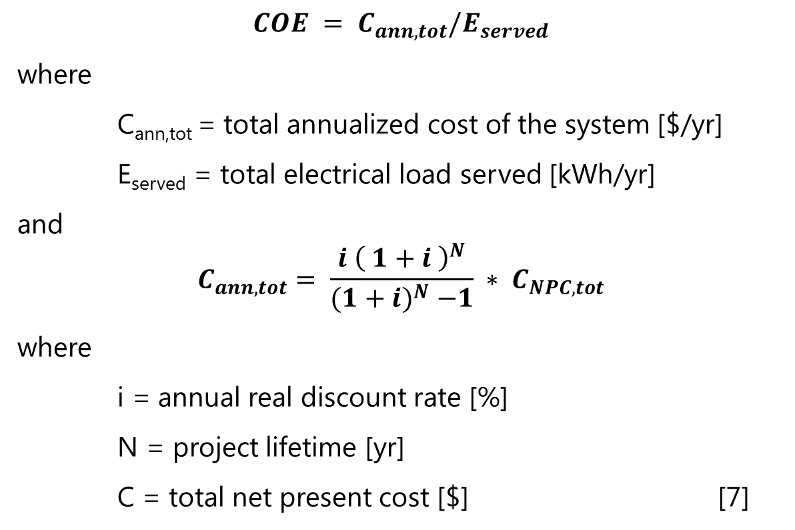
Calculations: COE

Slide 12
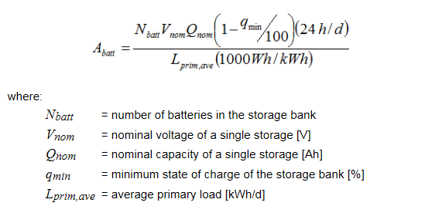
Calculations: Autonomy in Island Mode
  [8]

Slide 13
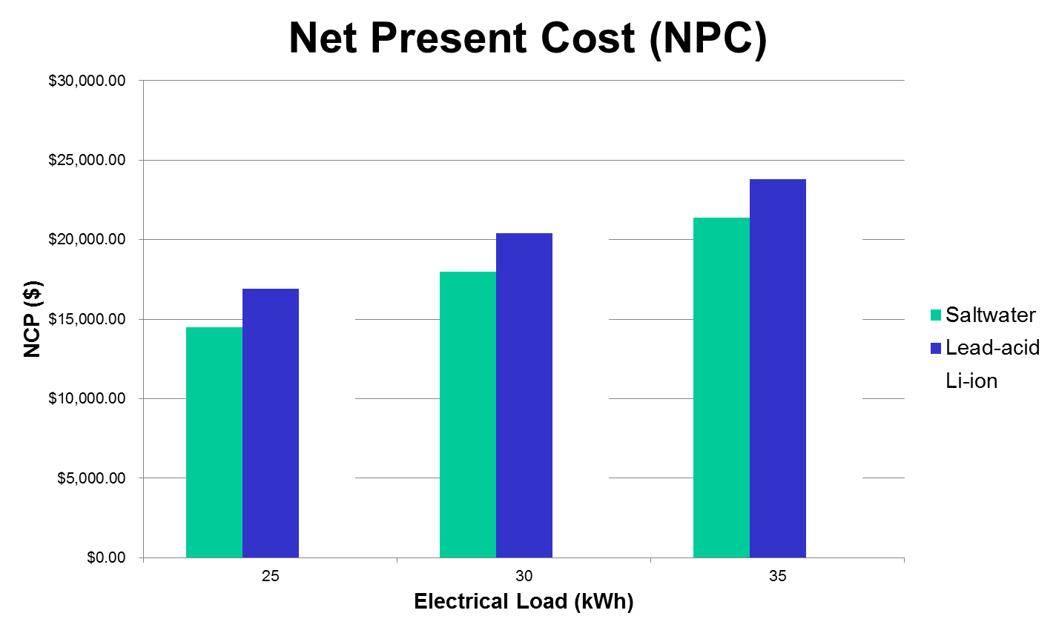
Economic Results

Slide 14
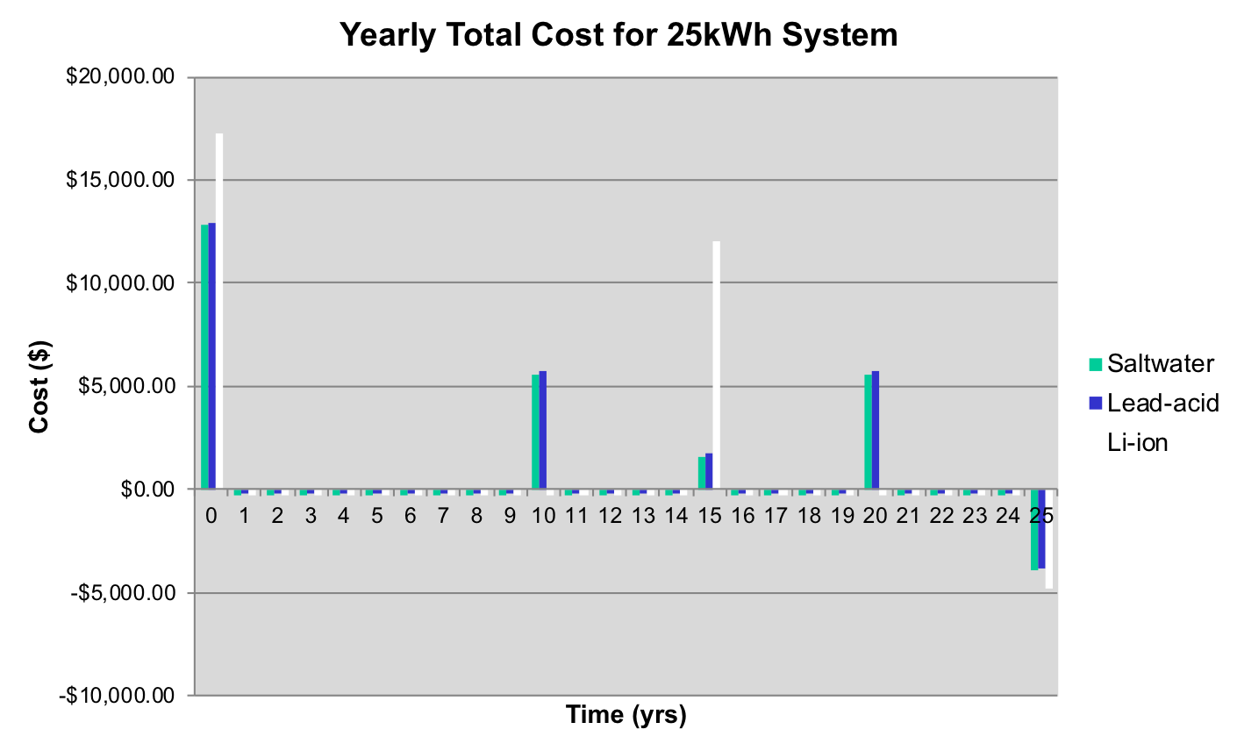
Economic Results

Slide 15
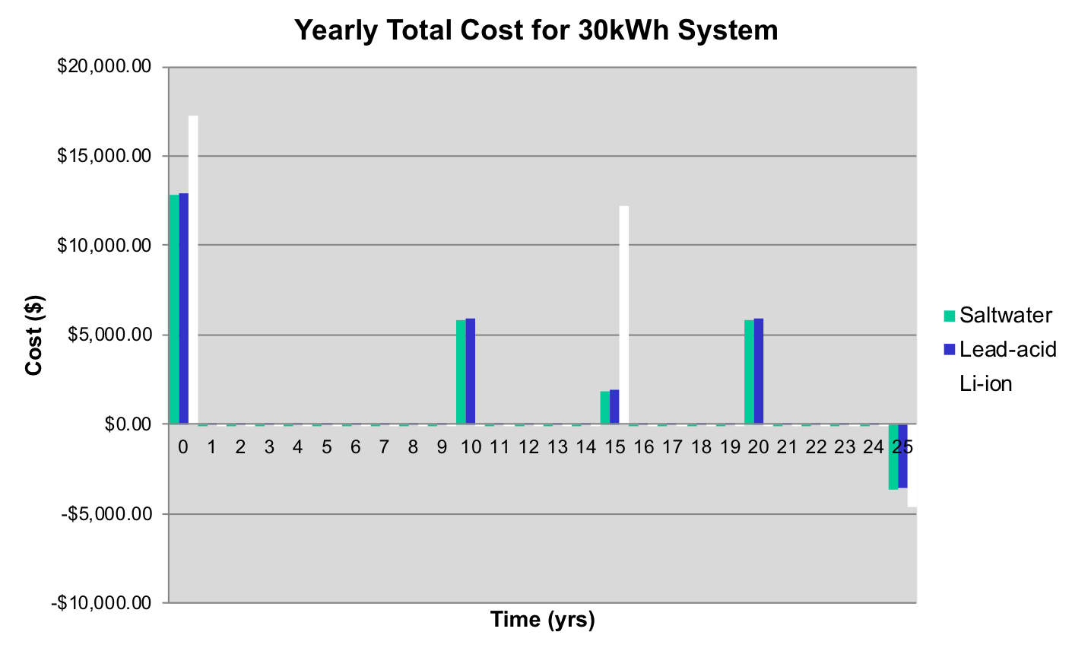
Economic Results

Slide 16

Economic Results

Slide 17
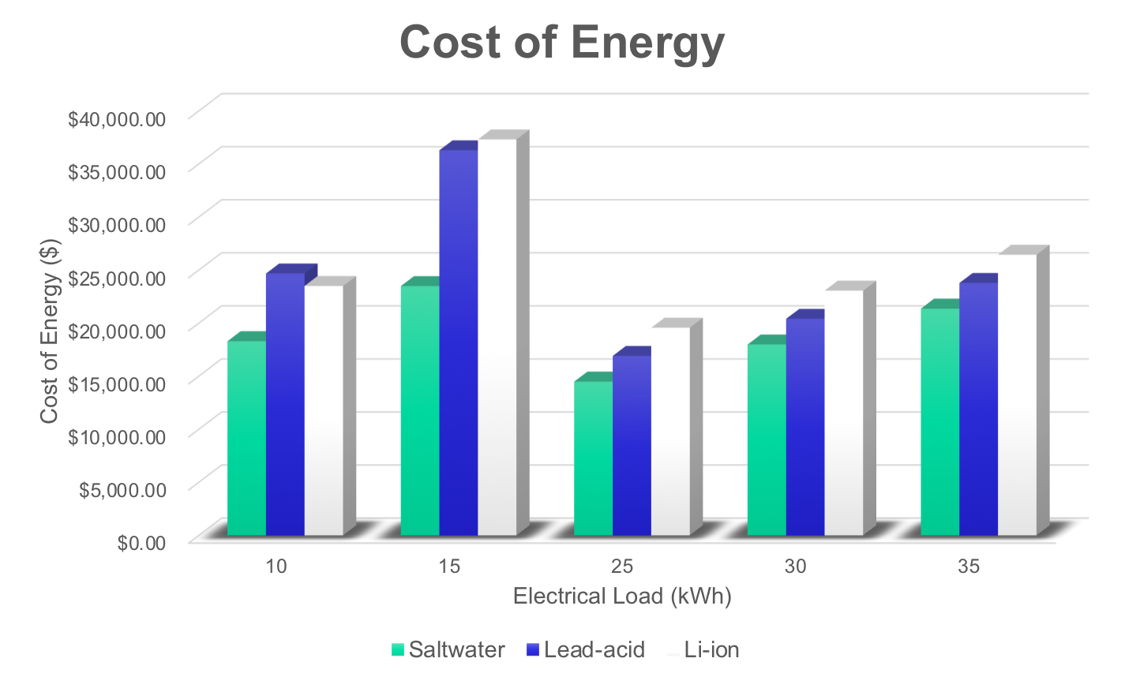
Economic Results
Notes:
NPC = lif-cycle cost of the system
CoE = the annualized cost of producing electricity by the total electric load served

Slide 18
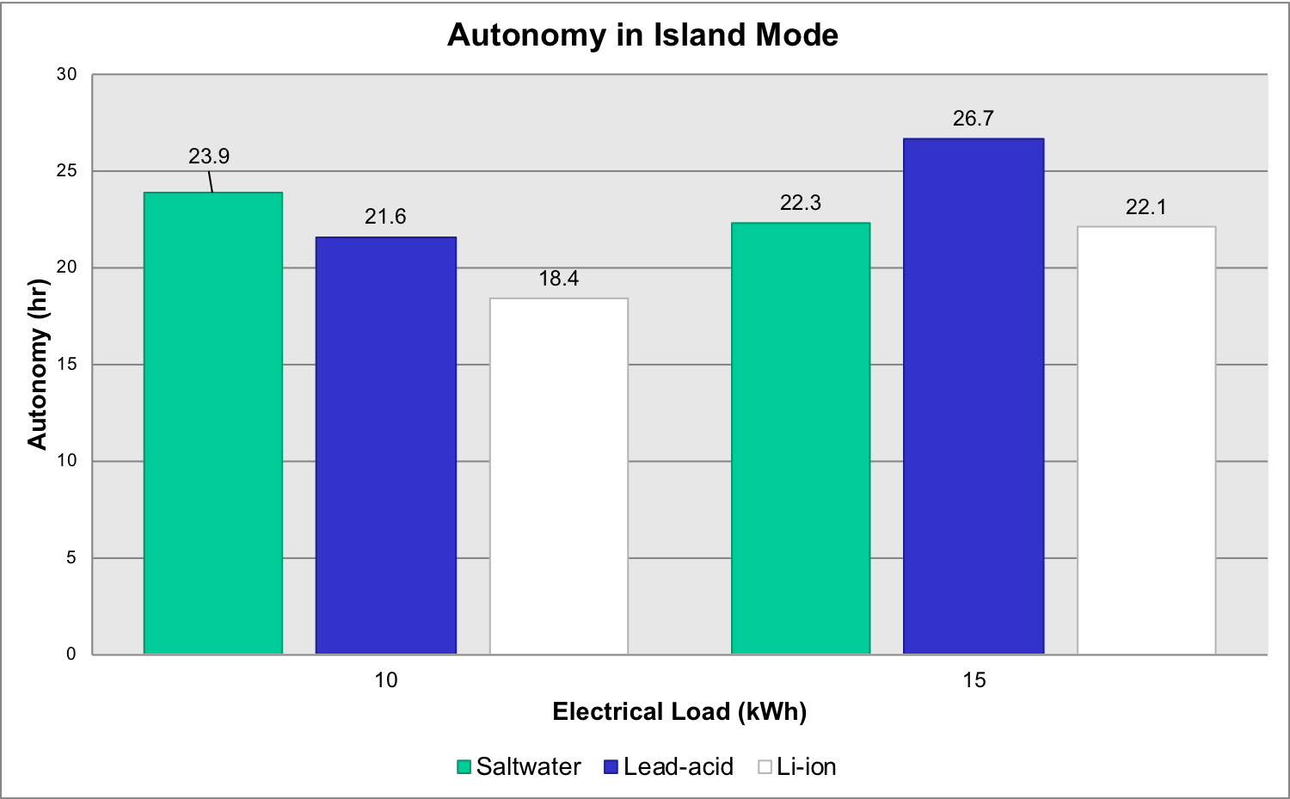
Island Mode Results

Slide 19
More Results
Battery | Height of 1 battery (in) | Width of 1 battery (in) | Length of 1 battery (in) | Weight of 1 battery (lbs)
Saltwater | 36.8 | 13 | 12.2 | 260
Lead-acid | 7.44 | 4.53 | 22.2 | 62.2
Li-ion | 8.9 | 6.75 | 12.75 | 28
Battery | # Batteries | Total Capacity (kWh) | Cost ($) | # Batteries | Area (ft^3) | Weight (lbs)
Saltwater | 5 | 9.96 | $5,895.00 | 5 | 16.89 | 1300.0
Lead-acid | 14 | 13.44 | $6,004.46 | 14 | 6.06 | 870.8
Li-ion | 10 | 9.96 | $10,399.90 | 10 | 4.43 | 280.0
Notes:
NPC = lif-cycle cost of the system
CoE = the annualized cost of producing electricity by the total electric load served

Slide 20
Conclusion
Winner: Saltwater Batteries
  pros
    lowest overall cost
    lowest cost of energy
    lowest cost per year
    close to 24 hour autonomy for both 10 kWh and 15 kWh loads
  cons
    batteries are physically large
    weighs 1300 lbs

Slide 21
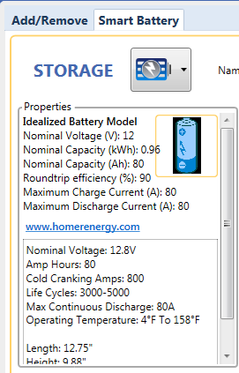
Limitations/Future Work
Due to datasheet limitations, idealized battery models were used
  which did not account for the decrease in energy provided and average power of the saltwater battery as the discharge time decreases
Was not able to properly evaluate the environmental impact of all three batteries have over the course of their lifetimes (from manufacturing to either recycling or waste)
Future work would be to remedy these two limitations to achieve a more accurate comparison

Slide 22
Main References
[1]S. N. Mahmood, A. Abdulabbas, H. Easa, and S. S. Algburi, “The battery characteristics impact on solar systems: Performance and cost,” Int. Conf. Curr. Res. Comput. Sci. Inf. Technol. ICCIT 2017, pp. 151–156, 2017.
[2]"Arizona Solar | SEIA", SEIA, 2019. [Online]. Available: https://seia.org/state-solar-policy/arizona-solar. [Accessed: 02- Jul- 2019].
[3]"Your 2019 Guide to Arizona Home Solar Incentives, Rebates, and Tax Credits", Solar Power Rocks, 2019. [Online]. Available: https://www.solarpowerrocks.com/arizona-solar/#incentives. [Accessed: 02- Jul- 2019].
[4]A. incentives, "2019 Arizona Solar Rebates and Incentives | EnergySage", Energysage.com, 2019. [Online]. Available: https://www.energysage.com/solar-panels/solar-rebates-incentives/az/. [Accessed: 02- Jul- 2019].
[5] W. Barber, "Arizona Commission Overhauls Rules for Net Metering, Distributed Generation", Renewable Energy World, 2017.
[6]“Net Present Cost", Homerenergy.com, 2019. [Online]. Available: https://www.homerenergy.com/products/pro/docs/latest/net_present_cost.htmlAccessed: 05- Aug- 2019].
[7]“Levelized Cost of Energy", Homerenergy.com, 2019. [Online]. Available: https://www.homerenergy.com/products/pro/docs/latest/levelized_cost_of_energy.htmlAccessed: 05- Aug- 2019].
[8]"Battery Bank Autonomy", Homerenergy.com, 2019. [Online]. Available: https://www.homerenergy.com/products/pro/docs/latest/battery_bank_autonomy.html. [Accessed: 05- Aug- 2019].

